Slide 1

Flocculation Model

Slide 2
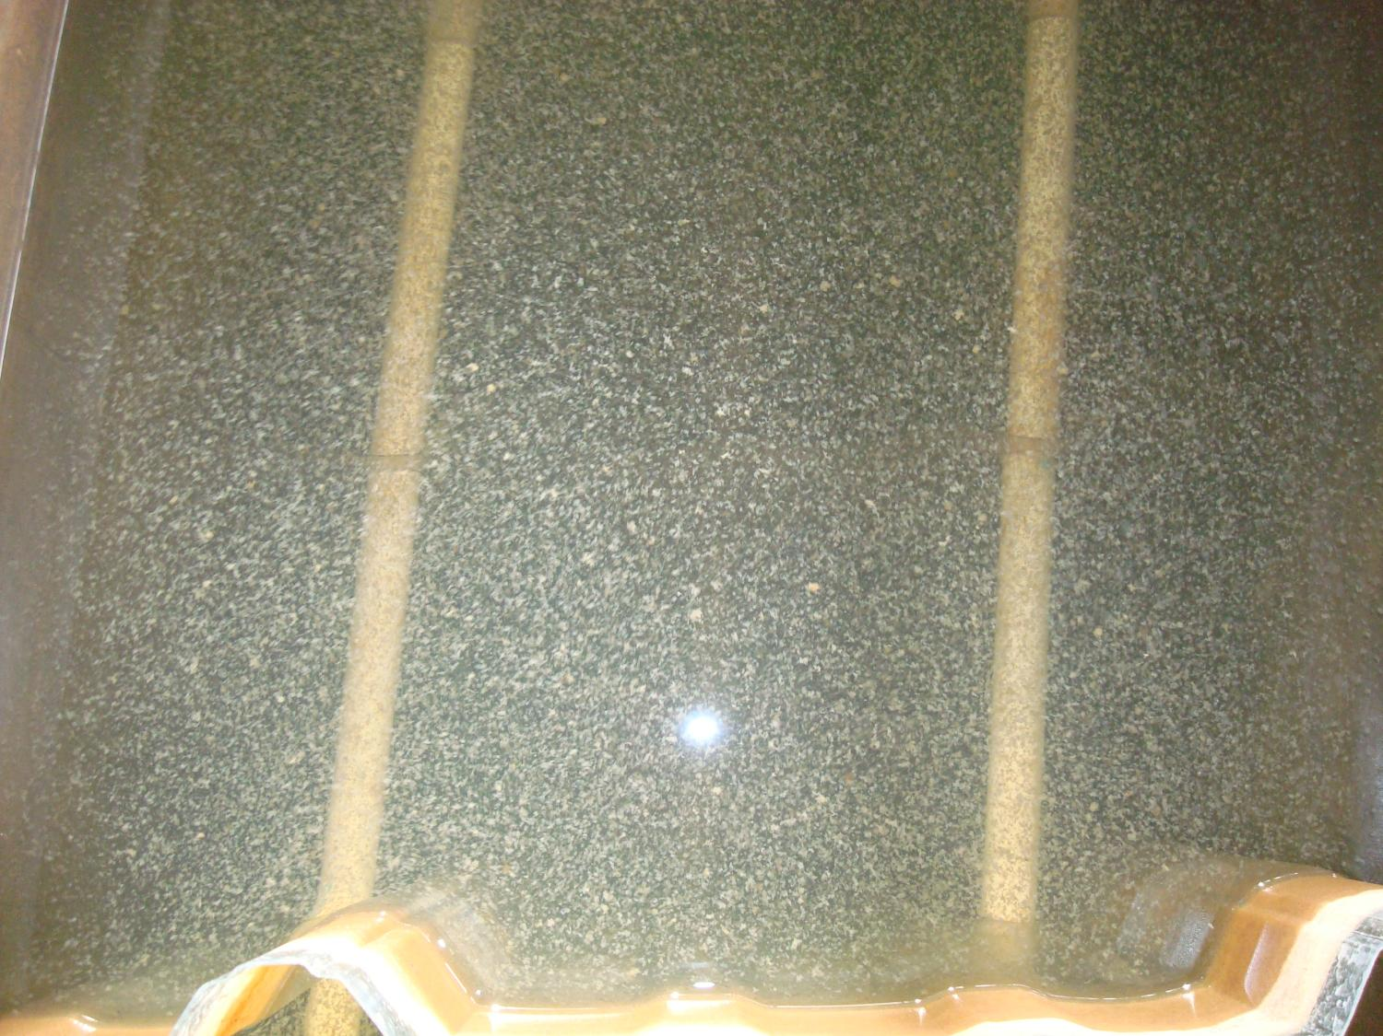

Slide 3
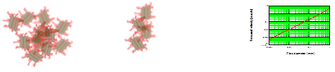
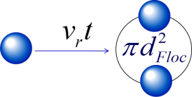
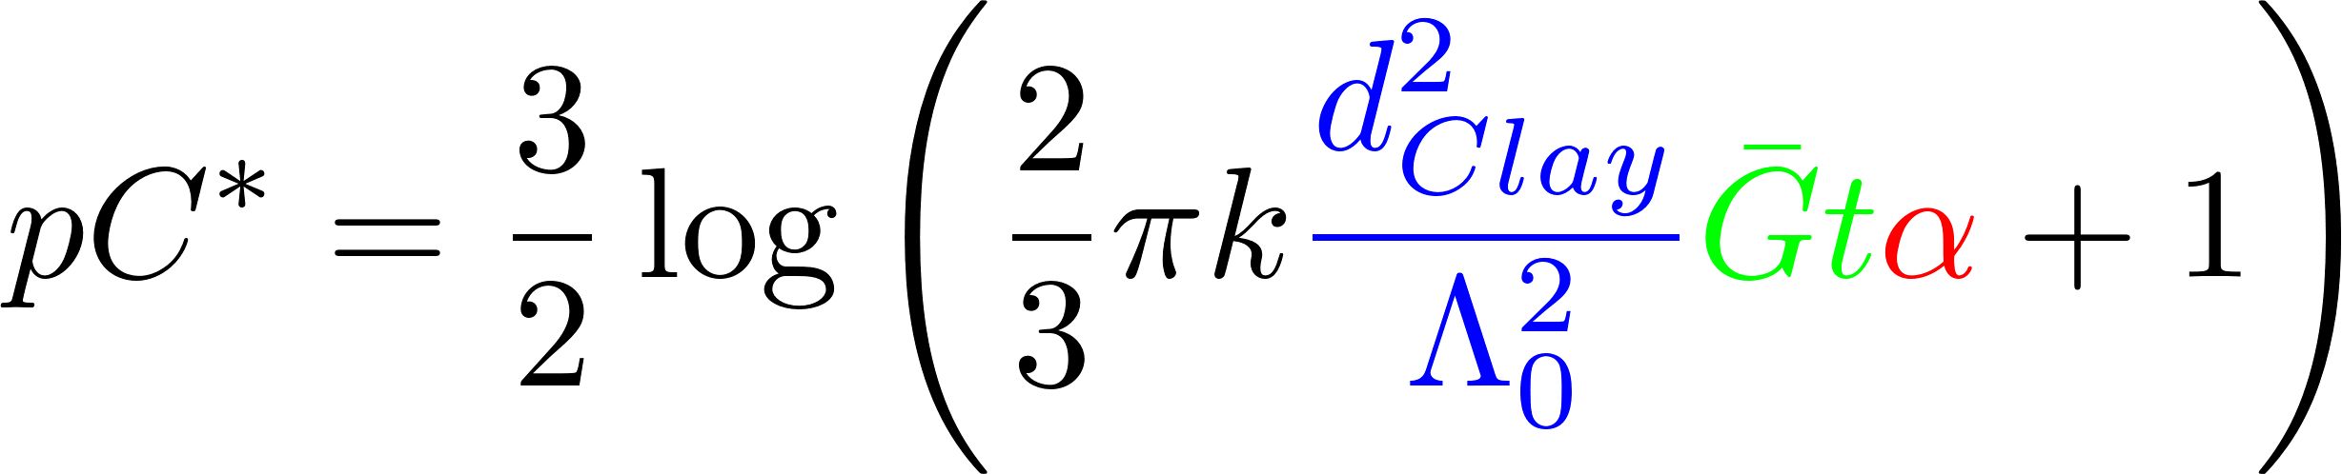
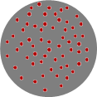
Overview
Creating collisions
Fractals
Collisions
Predictive model
Conclusions
Surface coverage

Slide 4
Energy Cascade
Origin of the energy is Mechanical energy – potential or kinetic)
Mechanical Energy is converted into turbulence
Flow expansion - deceleration
Wall shear
Turbulent kinetic energy (chaotic fluid motion – velocity) creates a cascade of eddies at smaller and smaller scales (deceleration happens at smaller and smaller scales)
Viscosity kills the tiniest eddies and converts the turbulent kinetic into heat

Slide 5
Viscosity kills Eddies : It takes work to deform the fluid!
Little eddy

Slide 6


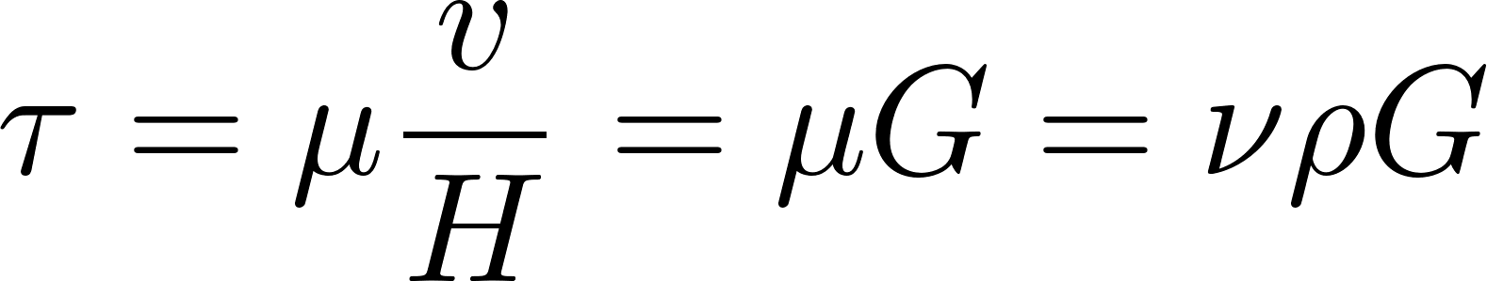
Fluids deform continuously (velocity gradient - G) given a stress (τ)
Dynamic viscosity
Kinematic viscosity
Velocity gradient

Slide 7
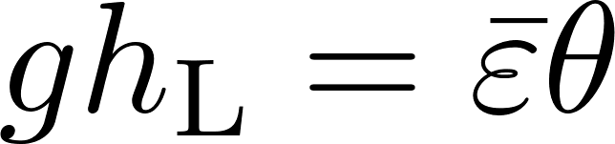
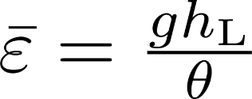
What is the Energy Dissipation Rate? (see AguaClara textbook)
Head loss is the result of dissipation of mechanical energy through viscosity to heat
Lost mechanical energy must be dissipated
Pipe wall shear creates a constant energy dissipation rate in the direction of flow when averaged across the pipe
Expansions (jets) create energy dissipation that decreases rapidly with distance downstream
Where θ is the time over which the energy is dissipated

Slide 8
Units of the Energy Dissipation Rate
The turbulent eddies cause stretching and thinning of concentration gradients and “shuffle” packets of fluid
The intensity of the turbulence can be characterized by the rate at which mechanical energy is being lost to thermal energy

Slide 9
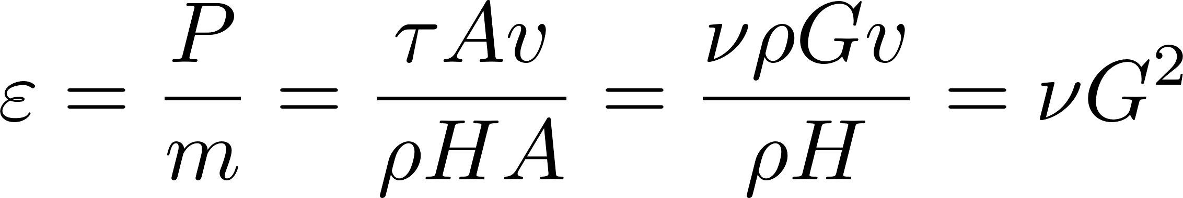
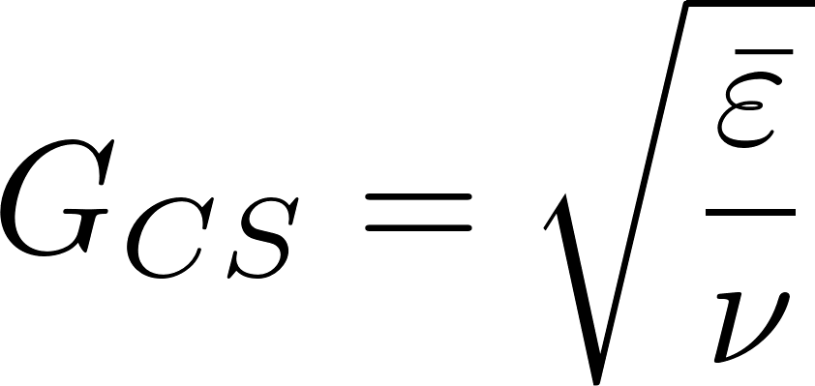
Energy dissipation rate and fluid deformation are linked
For a reactor with uniform energy dissipation rate
Camp Stein definition for a reactor with spatially varying energy dissipation rate
If energy dissipation rate is held constant and the temperature decreases, what happens to the velocity gradient
Increases
Decreases
Stays the same
Notes:
As temperature decreases viscosity increases.
As viscosity increases the velocity gradient decreases.

Slide 10
The Challenge of Flocculation
We would like to know
How do particles make contact to aggregate?
What determines the time required for two flocs to collide? (flocculation rate)
How would you design a flocculator for a target settled water turbidity?
How strong are flocs?
The challenge of the large changes in scale
The Al(OH)₃ nanoparticles begin at a scale of 10 to 100 nanometers
Flocs end at a scale of 100 micrometers
Flocculators are meters long
Notes:
10

Slide 11
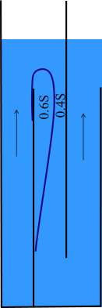
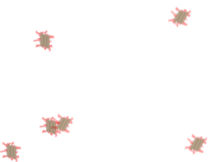
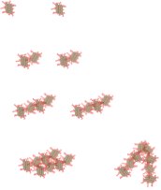
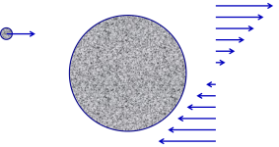
Fractal Flocculation Theory
Turbulence is caused by expansions
Particles and flocs are transported to collide with each other by viscous shear and Brownian motion.
Flocs grow in size with each successful collision
Collisions between particles of very different sizes are not very succesful.*
*evolving hypothesis. Current explanation is that each floc is dragging fluid around with it as it rotates and that fluid layer prevents collisions between different sized flocs
Flocculation model and collision potential for reactors with flows characterized by high Peclet numbers
Monroe L. Weber-Shirk ^{, a,} and ^{Leonard W. Liona}
http://dx.doi.org/10.1016/j.watres.2010.06.026

Slide 12

Primary particle does not attach to a large floc in uniform shear* (edge of knowledge alert)
Thickness of viscous boundary layer, d, scales with floc diameter
Relative velocity goes to zero at best location for contact
Only similar sized particles can extend through each other’s viscous boundary layer
Notes:
I haven’t been able to find literature that demonstrates this effect.
Likely that the water contained within a floc simply rotates with the floc and that no new water enters the floc in a shear flow.

Slide 13
Similar size flocs can collide and attach* (edge of knowledge alert)

Slide 14
Wait! How do the coagulant nanoparticles get to the clay?
Molecular diffusion transports particles that are smaller than about 1 μm
Shear transports new fluid past the clay particles and molecular diffusion transports the nanoparticles through the viscous boundary layer!
Nanoparticles can get to the clay!!!!

Slide 15
Flocculation models based on geometry and stickiness of nanoparticles can predict performance
The coagulant forms sticky nanoparticles
The bond between a coagulant nanoparticle and a clay platelet is strong
The bond between two coagulant nanoparticles is weaker
Macromolecules of natural organic matter (NOM) cover the coagulant nanoparticles (and NOM isn’t sticky)
There is still much to learn about flocculation!

Slide 16
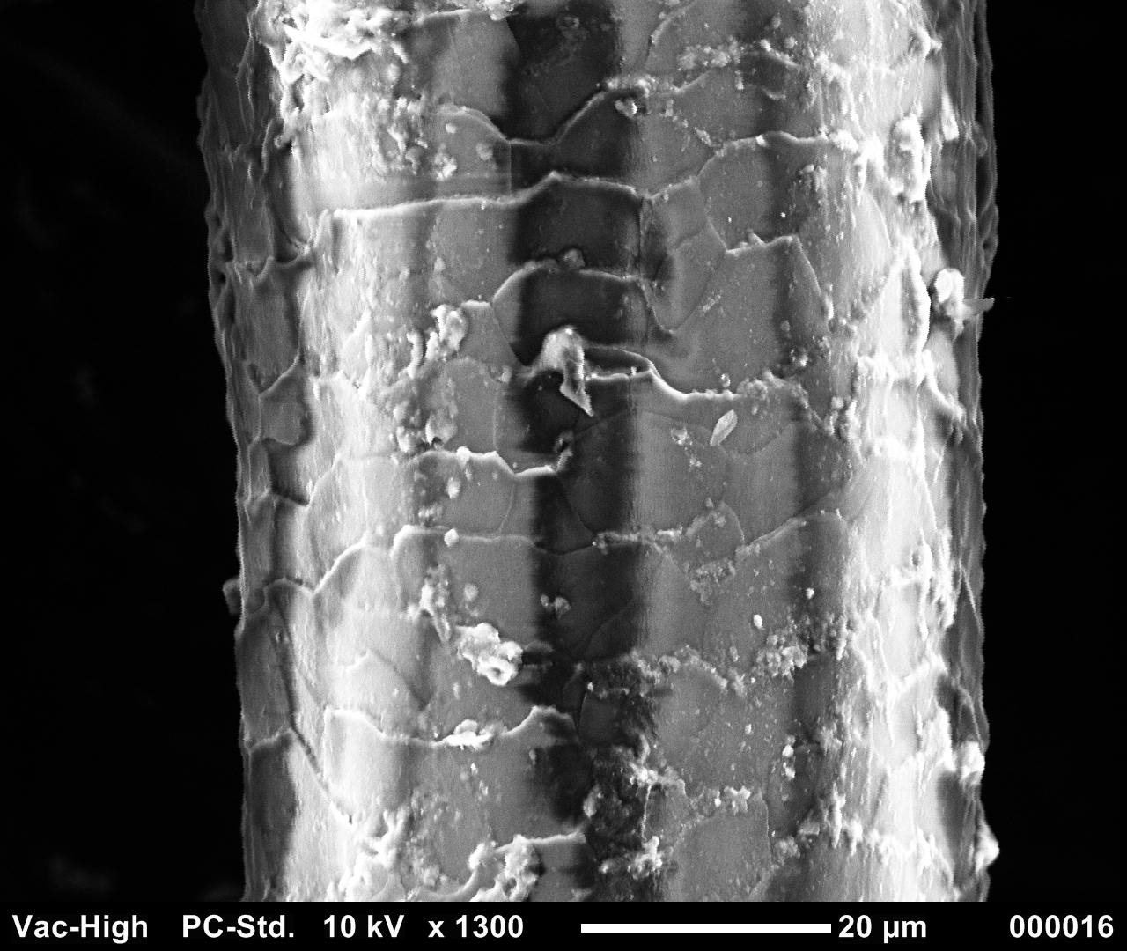
Human hair is 50 mm in diameter
clay
bacterial cell
Coagulant nanoparticle

Slide 17
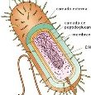
Sizes of a few particles
clay
7000 nm, 7 μm, 0.007 mm
bacteria
1000 nm, 1 μm, 0.001 mm
Nanoparticle of coagulant
90 nm, 0.09 μm
Natural organic matter
50 nm, 0.05 μm

Slide 18
How much coagulant should we add?
Our hypothesis:
When one clay platelet contacts another clay platelet, they will stick together if and only if there is a clean coagulant nanoparticle surface at the point of contact
We expect some aggregation to occur even with very low coagulant dosages
clay

Slide 19
How do the flocs grow?

Slide 20
The size changes produced by flocculation are dramatic
How many sequential collisions are required to make a 1 mm particle starting from 1 μm particles?
How much larger in volume is the 1 mm diameter particle?
____________
1,000
,000,000 !

Slide 21
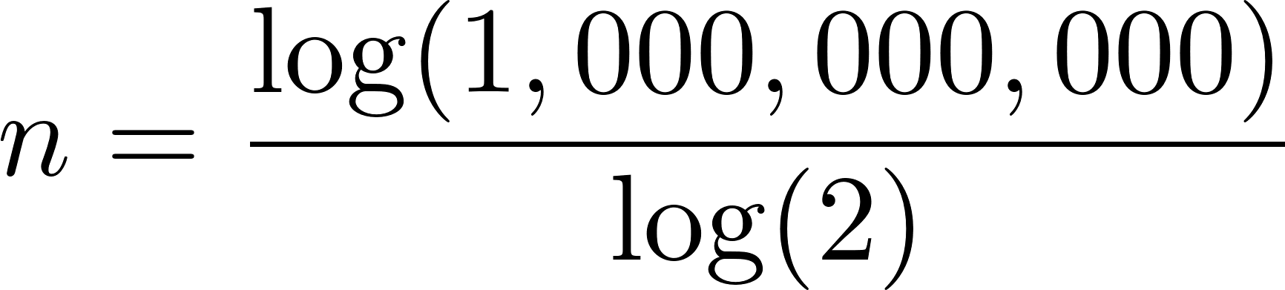
It requires many sequential doubling collisions to make a big floc
1 collision 1+1=2
2 collisions 2+2=4
3 collisions 4+4=8
4 collisions 8+8=16
Number of original particles in the floc = 2^{n}
What is n to obtain 1,000,000,000 = 2^{n}?
n=30
This assumes volume is conserved!
Notes:
Water droplets coalesce and conserve volume!

Slide 22
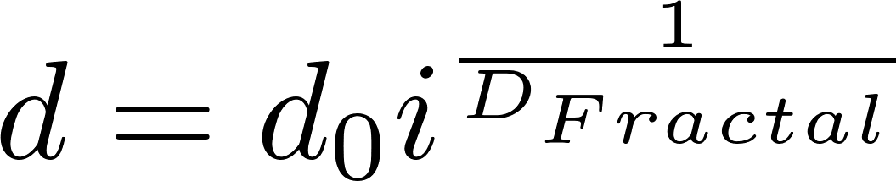
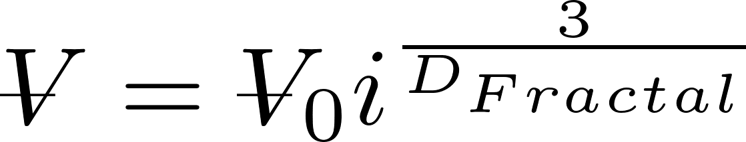
Fractals capture the idea that volume isn’t conserved
What happens to the density of a floc as it grows larger?
Floc density approaches the density of water because the floc includes water
diameter of primary particle
diameter of floc
Fractal dimension
Number of primary particles in the floc
3
If volume were conserved, what would D_{Fractal} be? ____
Is floc mass conserved? _____
No!

Slide 23
Fractal Geometry
Fractal geometry explains the changes in floc density and sedimentation velocity as a function of floc size
The fractal dimension of flocs is approximately 2.3 (based on floc measurements)
Further research to quantify the fractal dimension in flocculation is needed
Notes:
Adachi Wat. Res. Vol. 31, No. 3, pp. 449~54, 1997

Slide 24
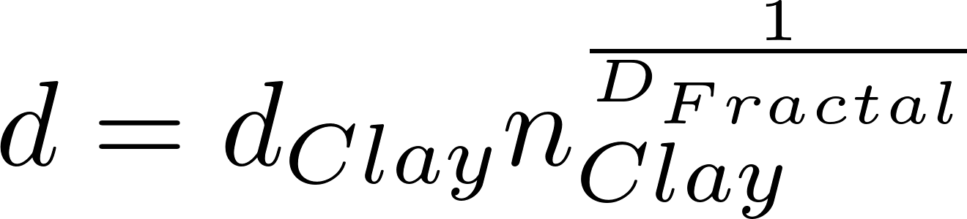
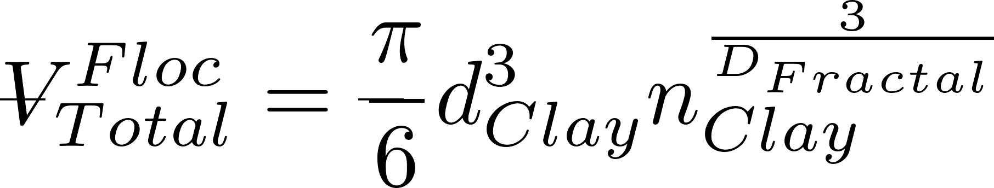
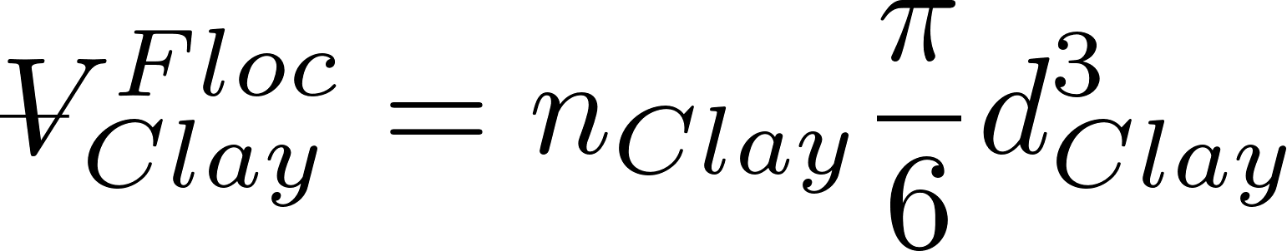
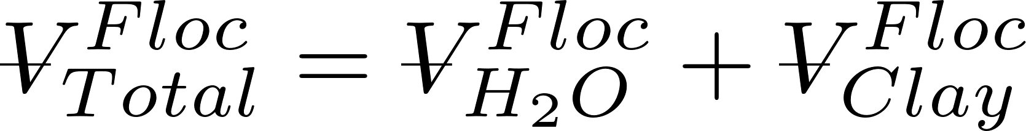

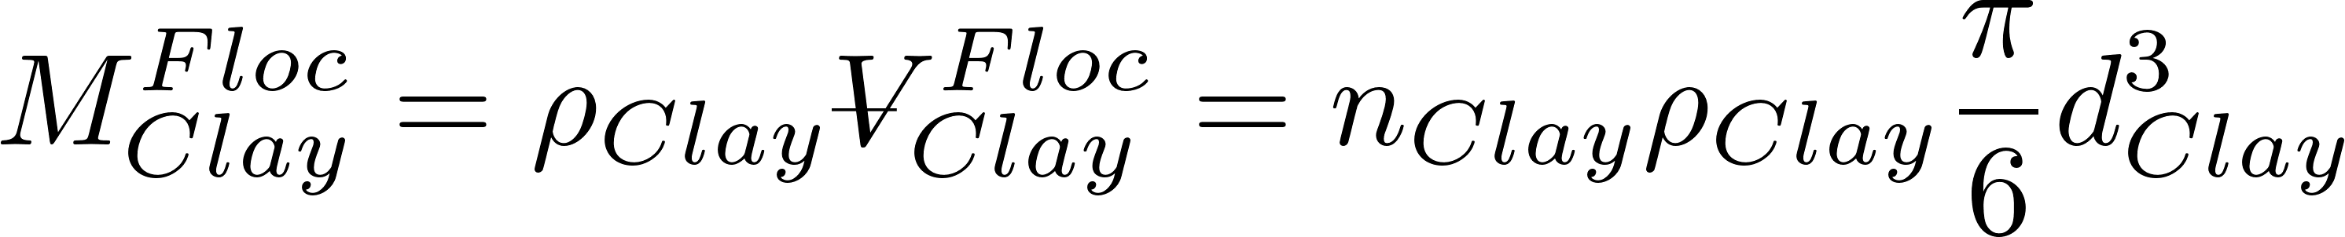
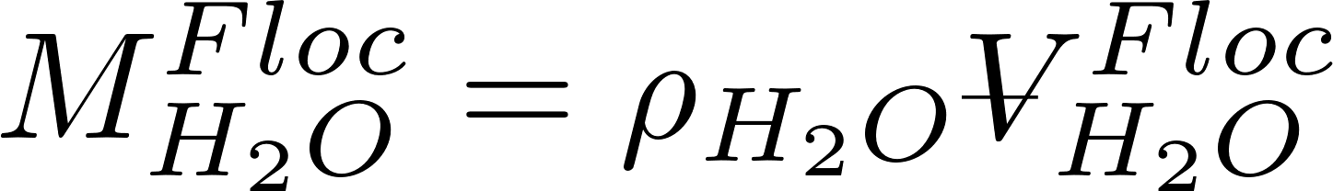
Clay + Coagulant nanoparticle density (clay dominates)
Floc diameter
Volume of clay in floc
Volume of floc made of water + clay
Mass of floc made of water + clay
Mass of clay in floc
Mass of water in floc

Slide 25
Clay + Coagulant nanoparticle density (clay dominates)

Slide 26
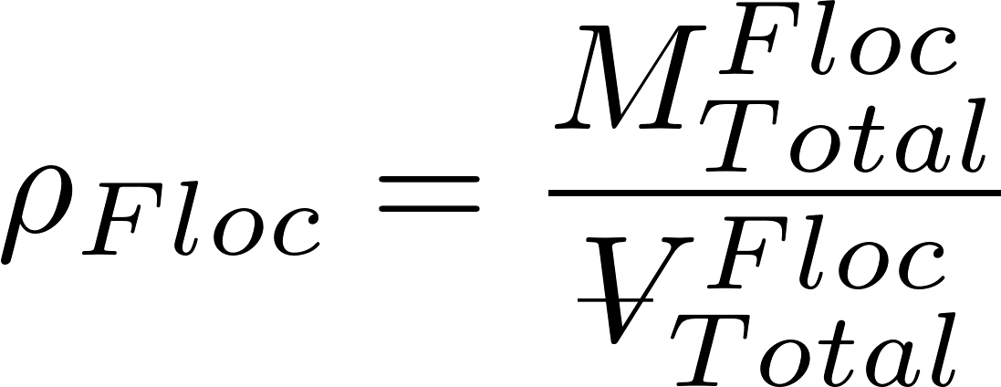
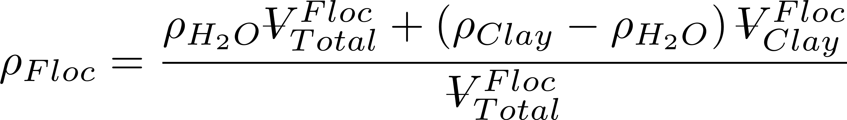
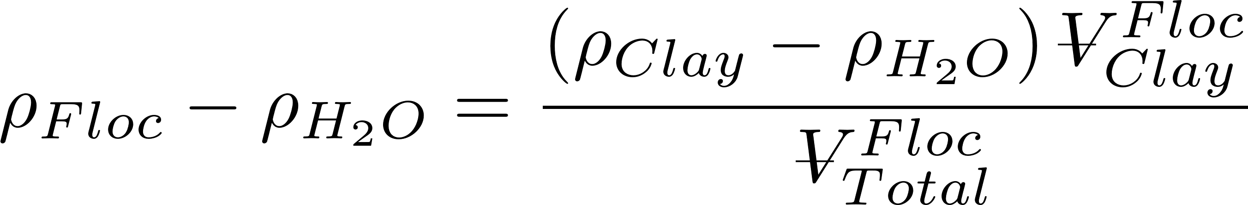
Clay + Coagulant nanoparticle density (clay dominates)
Subtract water density from both sides to get buoyant density

Slide 27
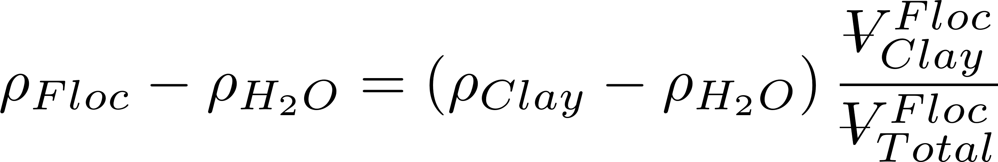
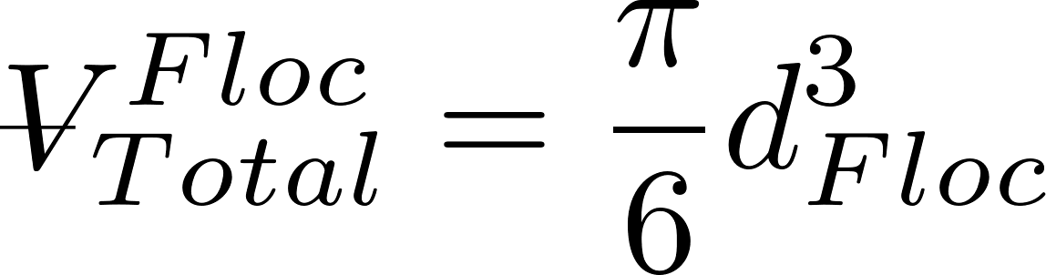
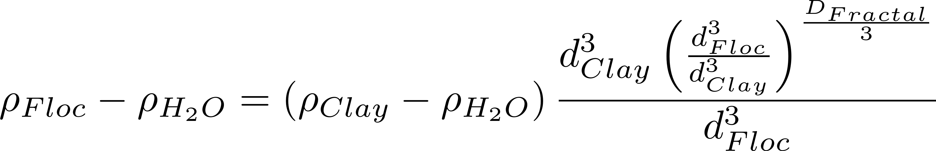
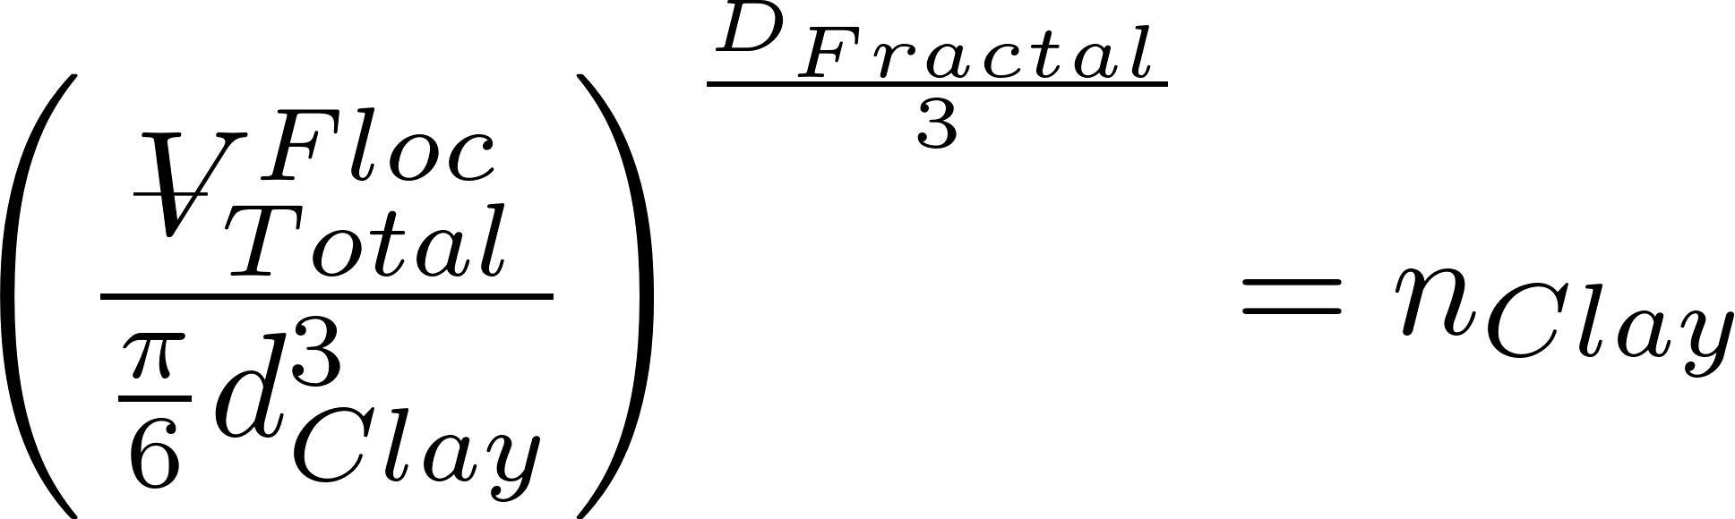
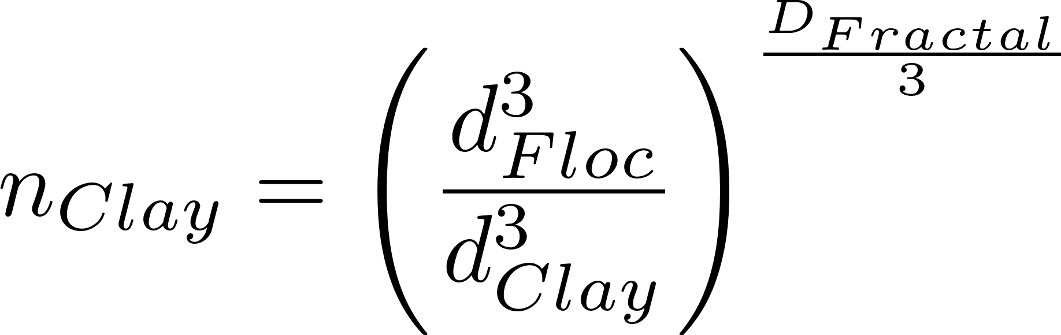
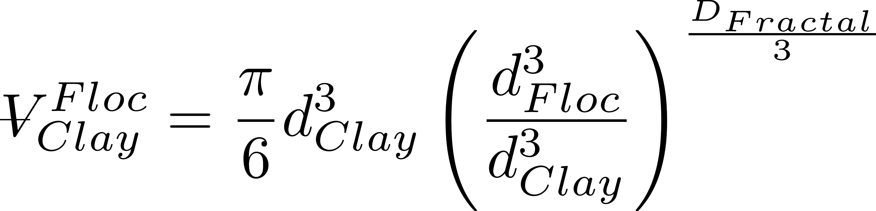
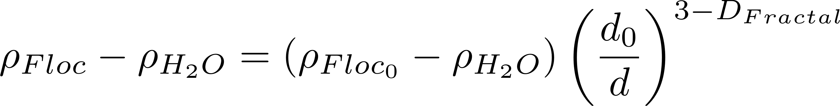
Clay + Coagulant nanoparticle density (clay dominates)

Slide 28
What happens as coagulant dose increases?
Coagulant nanoparticle aggregation begins
Collisions between nanoparticles and other particles and other nanoparticles are driven by diffusion
Perhaps the probability of a collision with clay or an other nanoparticle is based on the total surface area of the different types of particles
Perhaps assume that surface area is conservative even as the particles aggregate?

Slide 29
Floc Density Hypotheses (fluffy flocs)
Coagulant nanoparticles partially cover clay: core particle is clay with partial coverage by nanoparticles up to 50% coverage
core particle is clay coated with some coagulant nanoparticles
density must account for clay, coagulant nanoparticles, and water
Coagulant nanoparticles flocculate to same size as clay and then combine with clay (same size particles can collide):
core particle is part of a clay particle and part of a coagulant aggregate that is then coated with some coagulant nanoparticles

Slide 31
Buoyant Density of Flocs
Will these flocs settle faster than the primary particles?
Notes:
Here we assume that the primary particle (clay plus coagulant) is 1 micrometer in diameter.
The assumption is that we are starting with clay at 2650 kg/m^3.

Slide 32
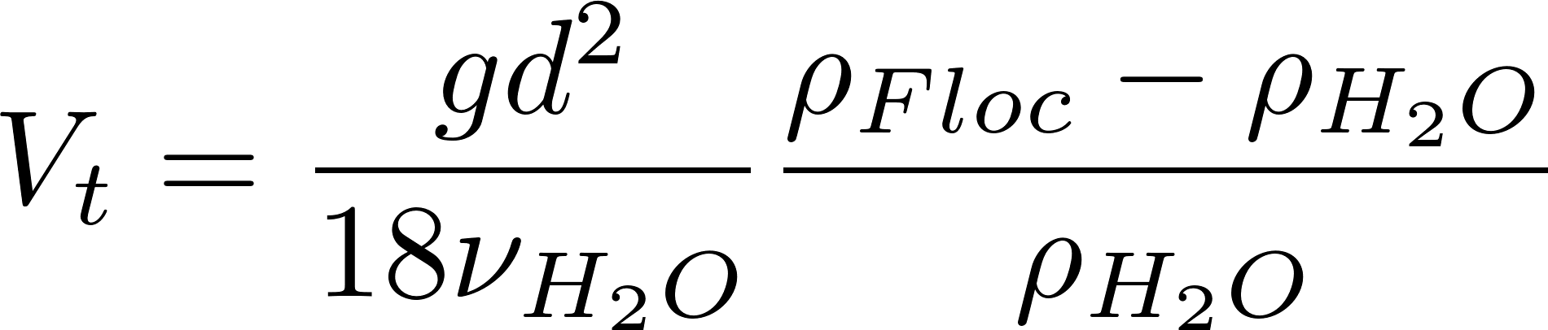
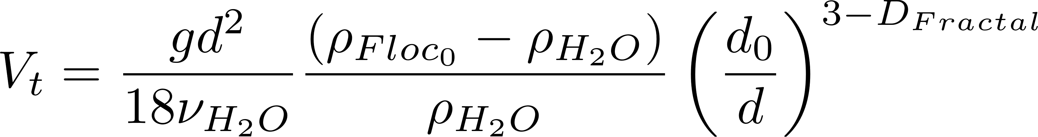
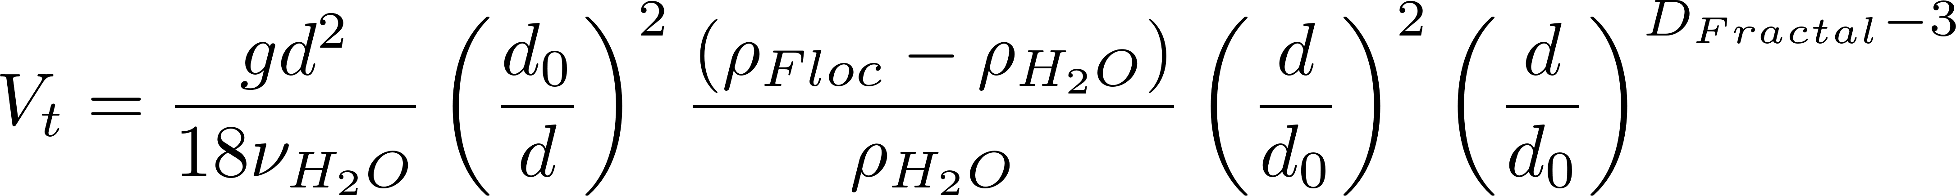
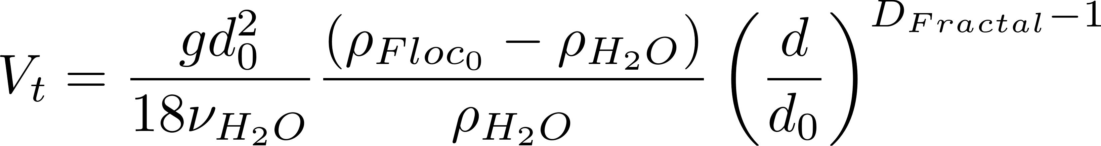
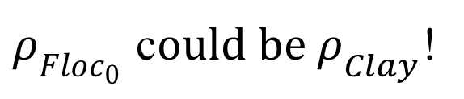
Fractal Terminal Velocity Equations
Buoyant density
Viscous flow terminal velocity
Algebra!
$ρ_{Floc_{0}}$ c$ould be ρ_{Clay}$!

Slide 33
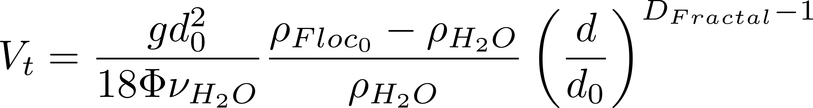
Floc Terminal Velocity
Laminar flow
Upflow velocity for floc blankets
Capture velocity for AguaClara plate settlers
Why flocculation is necessary!
1 μm
D_{Fractal} = 2.3 and d₀ = 1 μm
shape factor for drag on flocs
The model takes into account the changing density of flocs
Notes:
The shape factor adjusts the coefficient of drag for non spherical geometry and according to Tambo has a value of 45/24 for flocs (Tambo et al., 1979). This value is probably not yet well characterized. In any case it is expected to be order 1 because it is a correction to the drag coefficient due to shape.
All fractal dimensions greater than one are expected to increase the terminal velocity as the floc diameter increases.
Both floc blanket upflow velocity and plate settler capture velocity are AguaClara current design values, but are not optimized.

Slide 34
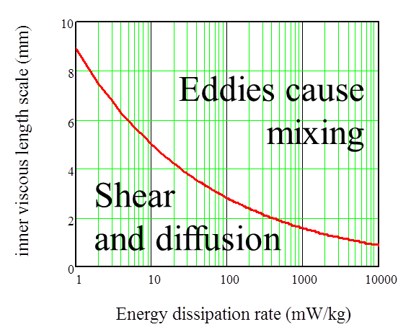
Collision Model of the Flocculation Process
The relative velocity between flocs is set by viscous shear because their separation distance is less than the inner viscous scale
The time required per collision is a function of the relative velocity between flocs, the average separation distance between flocs, and the floc size
In the next slides we will explore how to characterize collision time for flocs
We will assume that collisions occur between similar sized flocs. There is some evidence that flocs of very different diameters don’t collide.

Slide 35
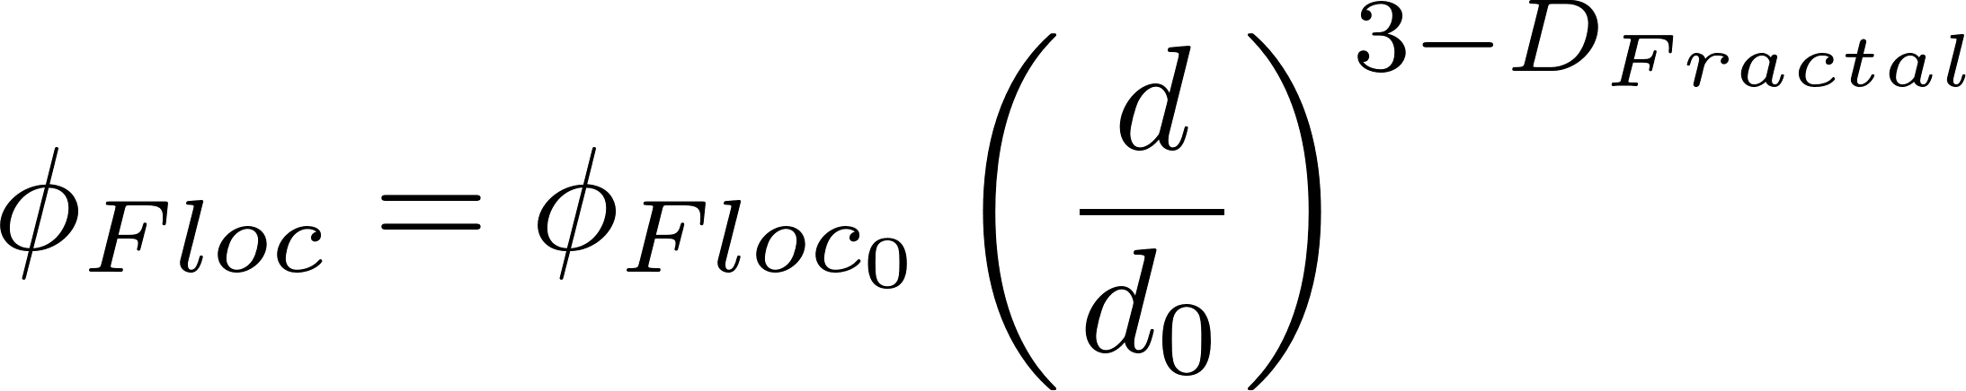
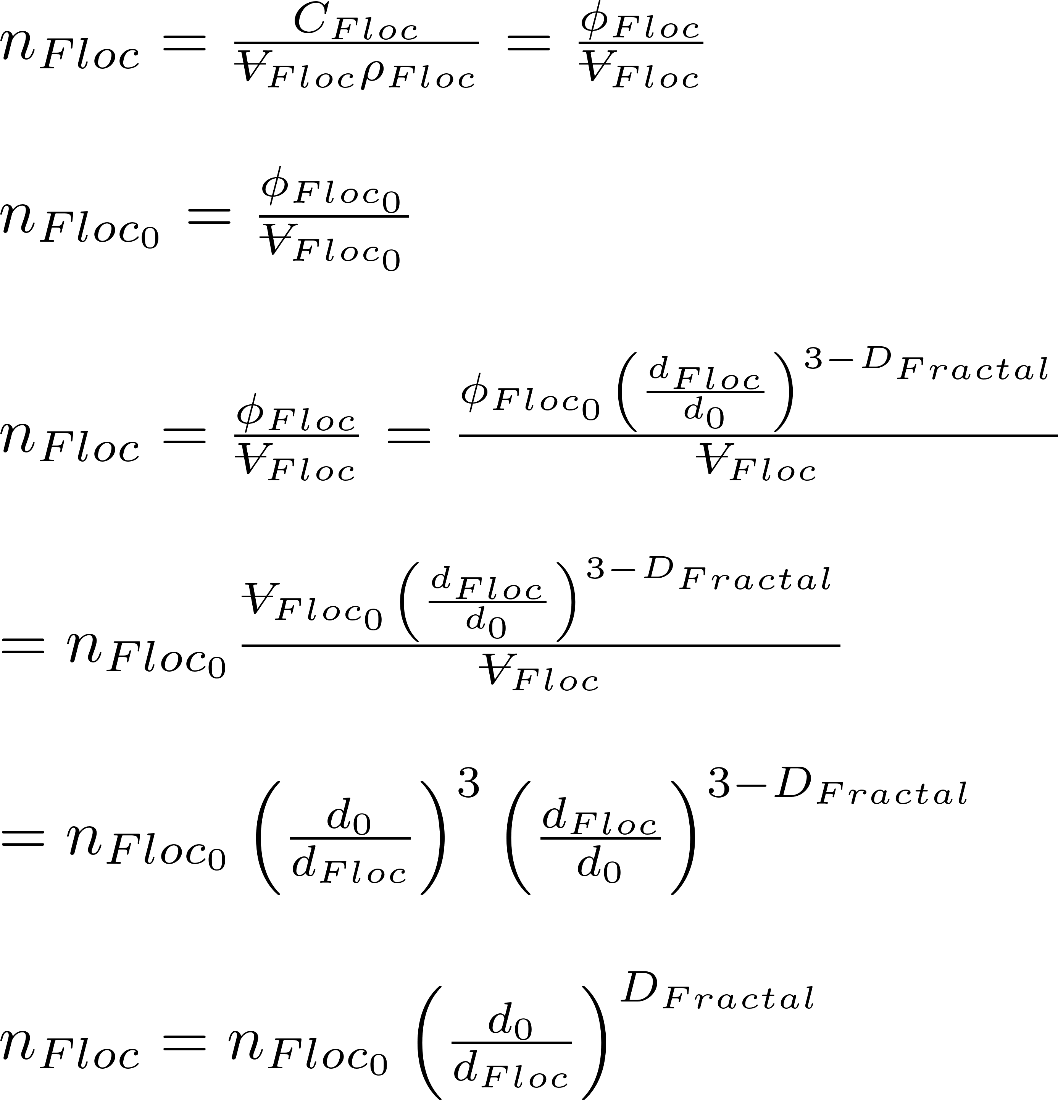
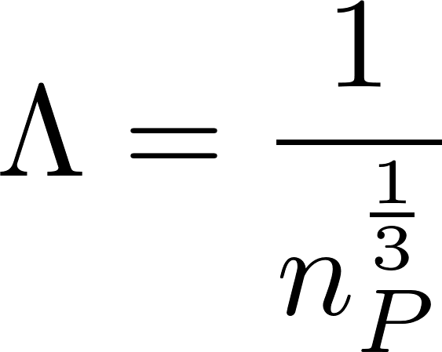
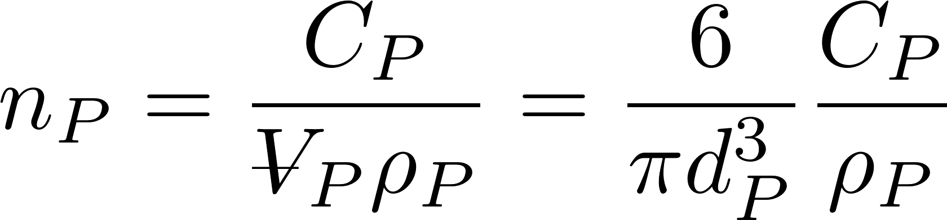
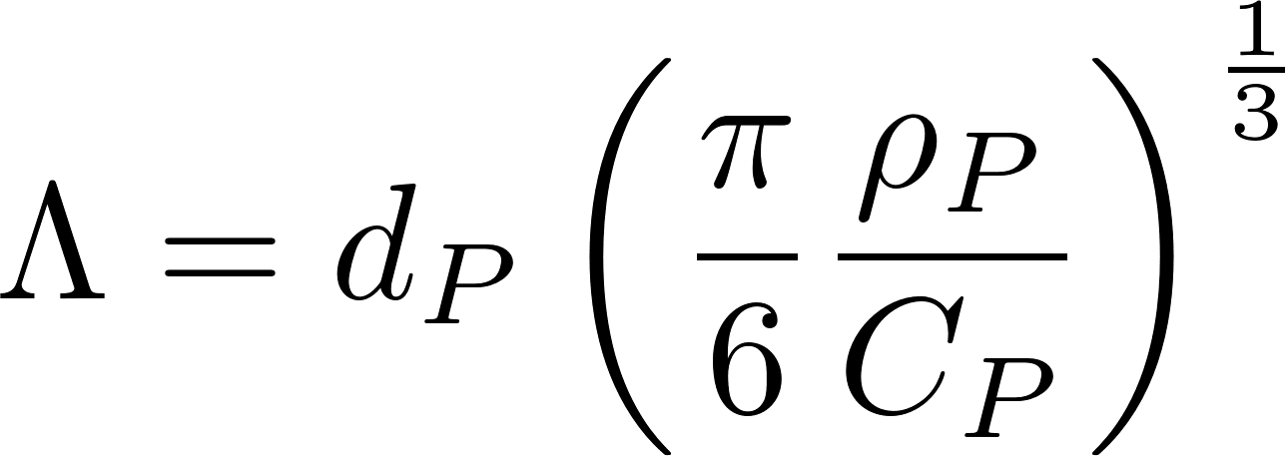
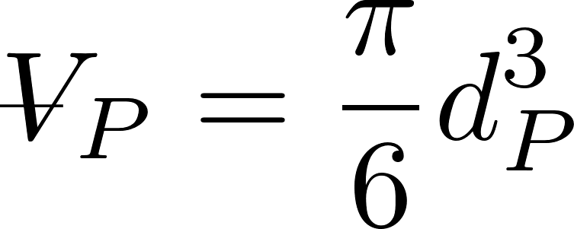
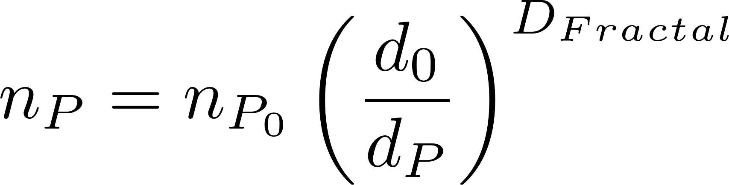
Average distance between particles is the cube root of the volume occupied (Λ)
extra
The average volume of water “occupied” by a particle!
Need to know number of particles per volume (n_{P})
The number of flocs decreases as the flocs grow in size

Slide 36
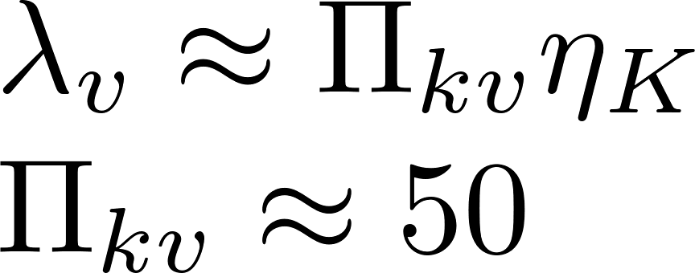

Particle collisions in flocculators (and rapid mix units!) are dominated by viscous shear
inertial
viscous
Particle separation distances are less than the viscous length scale
Notes:
http://dimotakis.caltech.edu/pdf/Dimotakis_JFM2000.pdf (see equation 20 for factor of 50)
Assume clay size is 4 microm.
Rapid mix exploration.xmcd

Slide 37


Hypothesis: Relative velocity scales with separation distance
Target
Notes:
Why is the path chaotic?
What is the relative velocity?
How far does the particle need to travel before there is a collision?

Slide 38

Coiled Tube Flocculation Residual Turbidity Analyzer
Dr. Karen Swetland Dissertation research
Notes:
Here we plotted the residual turbidity, the turbidity of the water after settling, against the coagulant dose. We noticed that when we used a log-log plot, there was a linear trend in the data. So we explored further.

Slide 39




Separation Distance Scaling
$$k=0.05$$
$$D_{Clay}=7 μm$$
$$D_{Coag}=20 nm$$
No evidence here of two flocculation regimes

Slide 40




Floc model for viscous dominated collisions
Particle diameter
Dimensionless concentration of particles that don’t settle
A function of fractional surface coverage of particle by coagulant
Flocculation time
Rate constant (model fitting parameter) : includes info on size distribution
Velocity gradient
Initial particle spacing

Slide 41






Model predictions?
Flocculator must be designed for target settled water turbidity

Slide 42




Primary particle concentration
k determined by William Pennock to have a value of about 0.03.
Clay diameter assumed to be 7 micrometer
68 NTU = 100 mg/L Kaolin clay
Coagulant nanoparticles = 90 nm in diameter

Slide 43
Surface Water often has Natural Organic Matter (NOM)
Coagulant nanoparticle
Natural Organic Matter (NOM)

Slide 45





Calculating attachment efficiency
Fraction of clay surface area coated by coagulant (this includes coagulant that is coated with humic acid)
Fraction of coagulant surface area coated by humic acid
Fraction of clay surface area that isn’t coated by anything
Fraction of clay surface area that is coated by clean coagulant
Fraction of clay surface area that is coated by coagulant that is coated by humic acid

Slide 46

There are 3 possible initial points of contact that can lead to attachment
The probability of a clay surface colliding with a PACl surface is equal to twice the probability that the first surface is clay and the second surface is the PACl surface of a PACl-HA nanoaggregate
The probability of a PACl surface colliding with a PACl surface
The probability of a PACl surface colliding with a HA surface

Slide 47

Dissolved organic matter changes flocculation
90% removal
-log of fraction remaining
Increased humic acid

Slide 48

Settled water turbidity can be predicted!
90% removal
-log of fraction remaining

Slide 49
The flocculation model is far from complete
Doesn’t predict decreasing performance at high coagulant dosages
Likely that coagulant-coagulant bonds are weaker than coagulant-clay bonds and we don’t yet have that effect in the model
Doesn’t describe floc formation when the dissolved organics concentration is so high that bonds are significant
Doesn’t describe effects of sedimentation tank design (we are working on this!)

Slide 50

4 major assumptions of the AguaClara Hydraulic Flocculation Model
Long range transport velocity to a collision scales with the average separation distance of the particles
Relative velocities between particles are dominated by viscous shear (not inertia)
Separation distance is smaller than inner viscous scale
In fluid shear only similarly sized particles can collide
Plug flow!

Slide 51






What does Gt mean?
y
y
velocity
Displacement in time t
$$v_{r}$$
$$Λ$$
u
x
$$L_{Deformation}$$
Definition of velocity gradient
Find relative velocity between flocs separated by distance $Λ$
The relative distance traveled due to fluid deformation is proportional to time
A Gt of 1 means that the particles have a relative displacement equal to their separation distance

Slide 52
Fractal Flocculation Conclusions
It is difficult to flocculate to a low residual turbidity because the time between effective collisions increases as the number of primary particles decreases
Primary particles can’t attach to flocs in shear flow
Likely because of the boundary layer of fluid around the floc
Getting rid of the last primary particles is our challenge!

Slide 53
Review
Why does increasing initial turbidity decrease the initial time between collisions?
Which terms in the model are determined by the flocculator design?
The model assumes plug flow!
Notes:
Less volume to clear before the next collision
Gt

Slide 54
Model assumption differences are about the relative velocities
Classic particle collision models assume that the average relative velocity of two particles is set by the length scale of the diameter of the particles regardless of their separation distance
We hypothesize that the majority of the transport time is spent in a long random walk with relative velocities based on the average particle separation distance (Λ)*
* Edge of knowledge

Slide 55



Proposed (Λ) Long Range Transport Hypothesis*
At all times there exists a differential VOLUME of fluid that will transport any particle with its center located within that differential VOLUME to a collision of the particle and collector between and
The time required for that final transport to a collision is
Long range transport delivers the particle to the differential volume for the final slow transport to the collision
Next… characterize the time for the long range transport
* Edge of knowledge
Notes:
This is not clear. There seems to be an important assumption about this being a volume rather than an area to take into account the fact that flocs are 3 dimensional and not 2 dimensional. It seems that conventional collision models assume that particles are 2 dimensional.

Slide 56





How much water is cleared (filtered) from a floc’s perspective?
Volume cleared is proportional to a collision area defined by a circle with diameter = sum of the particle diameters
Volume cleared is proportional to time
Volume cleared is proportional to the relative velocity between flocs

Slide 57












Use dimensional analysis to get a relative velocity
Velocity scales with
Λ is separation distance
Assume linear velocity gradient
Velocity gradient
dimensions
Notes:
The length scale is the average separation distance of the flocs

Slide 58









Collision rates for the two assumptions
t_{c} is average time per collision
Relative velocity
Time for one collision
$N_{c}$ is number of sequential collisions that result in aggregation.
α is probability of attachment given a collision
Notes:
Find the time to clear the volume occupied by one floc.
Then we need to find the average relative velocity of the two flocs based on their average separation distance.

Slide 59








Collision Rate and Particle Removal
Track fraction of small particles if all particles are active
Geometry
Track small particles as flocculation progresses with small particle number concentration, n_{p}, as our master variable (track settled NTU)
d.T is the characteristic diameter of the actively growing flocs
First order conversion of small particles to flocs with respect to the number of collisions
Small particles are converted into large flocs by collisions with small particles
Tracking residual turbidity!

Slide 60


















Integrate
Particle size and density is assumed constant because the model is tracking the small particle population that won’t be removed during sedimentation.
What is the p function?

Slide 61
pC*: A dimensionless measure of removal efficiency
Sloppy parlance… log removal
What is the target effluent turbidity for a water treatment plant?
What is pC* for a water treatment plant treating 300 NTU water?
What is required effluent turbidity?
How many orders of magnitude reduction?
Notes:
Goal is low turbidity settled water. Turn ALL small particles into flocs that are large enough to be removed by sedimentation (80 micrometers in diameter).

Slide 62









We can test the collision models with laboratory data
Data will converge if we choose the right dimensionless grouping
Plot performance as a function of this dimensionless group

Slide 63

Comparison of classic and hypothesized collision models
Classic model: transport and mixing at length scales larger than the diameter of the particle do not influence collisions – therefore slow, long, straight walk toward a collision
Hypothesized model: fast random walk clearing volume of fluid equal to volume occupied followed by slow, short, straight walk toward a collision*
* Edge of knowledge

Slide 64
Classic Models: Relative velocity scales with diameter

Slide 65



Diameter Scaling
$$k=1$$
$$D_{Clay}=7 μm$$
$$D_{Coag}=20 nm$$
Notes:
Analysis by William Pennock, 2016
This clay size may be larger than realistic and the nanoparticles may be smaller than what was produced by the granular PACl used by Karen.

Slide 66
Relative velocities appear to scale with average separation distance
These results appear to be different than classic particle collision models
There might be a confounding assumption that leads to these surprising results
Big flocs are useless
Small flocs disappear at a rate proportional to the number of their collisions
?

